Slide 1

RETINA BASED BIOMETRIC RECOGNITION SYSTEM
V.V.Sangha’s
RAO BAHADUR Y MAHABALESWARAPPA ENGINEERING COLLEGE
Department of Computer Science & Engineering
Accredited by National Board of Accreditation
Batch Number:A9
by,
3VC15CS053:Meghana K
3VC15CS050:Manjula G P
3VC15CS027:G Ramya
3VC14CS112:Veluru Eswari
Under the guidance of,
Mr. Puneeth G J ,
Assistant Professor,
Department of CSE,
RYMEC

Slide 2
Contents
Introduction
Literature Survey
Area and Problem statement
Objectives
Methodology
Advantages and Disadvantages
Conclusion
Snapshots
References

Slide 3
Introduction
A biometric system is a pattern recognition system that checks the authenticity of a person using biometric measures.
There are two types of authentication: - verification (checking the validity of a given identity) and identification (checking if given pattern is associated with any of the enrolled identities stored in database).
The retina is an internal protected organ of the body. Human retina consists of blood vessels which form a unique pattern and the pattern does not change through the individual’s life. So it is impossible to forge that pattern.
Retina based security system works by tacking an image of an individual’s retinal blood vessel network and comparing it to a previously authenticated scan of the same individual.
The uniqueness and stability of retina guarantees a strong biometric authentication. Also it is less vulnerable to identity theft.

Slide 4
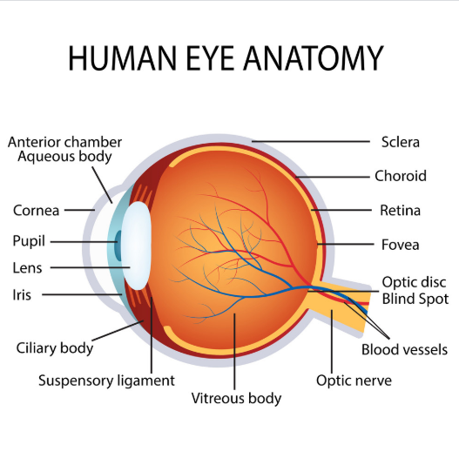
Introduction
F
Fig 1: Human eye
Cornea is a clear front window of the eye that transmits and focuses light into the eye.
Iris is a colored part of the eye that helps regulate the amount of light that enters.
Pupil is a dark aperture in the iris that determines how much light is let into the eye.

Slide 5
Introduction
Lens is a transparent structure inside the eye that focuses light rays onto the retina.
Retina is a never layer that lines the back of the eye, senses light, and creates electrical impulses that travel through the optic nerve to the brain.
Macula is a small central area in the retina that contains special light sensitive cells and allows us to see fine details clearly.
Optic nerve is a connects the eye to the brain and carries the electrical impulses formed by the retina to the visual cortex of the brain.
Vitreous is a clear, jelly- like substance that fills the middle of the eye.
The ciliary body is a circular structure that is an extension of the iris, it produces the fluid in the eye called aqueous humour. It also contains the ciliary muscle, which changes the shape of the lens when your eyes focus on a near object.
The retina blood vessels are the central retinal artery and vein, and their branches .

Slide 6
Literature Survey
SIno | Title | Author and Year | Method Used | Proposed work/conclusion
1 | Identity verification using iris images: performance of human examiners | k.McGinn, S.Tarin was published paper in the year 2013 | Identity verification : Two images of the same eye of the same person, or Images of two different eyes, with the individuals having the same gender, ethnicity and approximate age. | Systematic investigation of how well human examiners perform at identity verification using the same type of images as acquired for automated iris recognition.

Slide 7
Literature Survey
Sl no | Title | Author and Year | Method used | Proposed work/conclusion
2 | A visually interpretable iris recognition system with crypt features | F. Shen was published a paper in the year 2014 | One important barrier to the use of current iris recognition techniques in law enforcement areas such as forensics is that the iris features used by these techniques are not interpretable to human eyes | This dissertation proposes a novel iris recognition technique that determines a human’s identity based on the crypt, a visible feature on the iris.

Slide 8
Literature Survey
Sl no | Title | Author and Year | Method used | Proposed work/conclusion
3 | Iris recognition system | Sevugan, Prabu and Swarnalatha, p. and Gopu, magesh and Sundararajan, Ravee was published a paper in the year 2017 | The IR recognition method is described in 4 steps: Image Acquisition Segmentation Normalization Feature encoding&matching | The main aim of an iris recognition system is to have the capacity to accomplish a distinct segregation of intra class and inter class shamming distance distribution.

Slide 9
Literature Survey
Sl no | Title | Author and Year | Method used | Proposed work/conclusion
4 | Iris technology: A review on iris based biometric systems for unique human identification | Dr M V Bramhananda Reddy, Dr V Goutham was a published a paper in the 2018 | Proposed an algorithm for iris segmentation using Circular Hough transform and K-means algorithm. The experiments were made on iris recognition in unconstrained environments. | In this, our focus is on iris as biometrics feature for secure authentication of humans uniquely across the globe.

Slide 10
Area and Problem statement
Area: Image Processing
Problem statement: Biometric security has become more important because of the increasing activities of terrorism and hackers . Retina recognition technology is continuously growing over years, this technology can resolve the identification of a persons identity, the main purpose of this project is to develop an retina based biometric recognition system for authenticating individual’s

Slide 11
Objectives
The main objective of this project is to identify a person/individual through their retina.
To track an image of an individual’s retinal blood vessel network.
To compare tracked retinal blood vessel network with previously authenticated scan of the same individual.

Slide 12
Methodology
Fig (a): System architecture

Slide 13
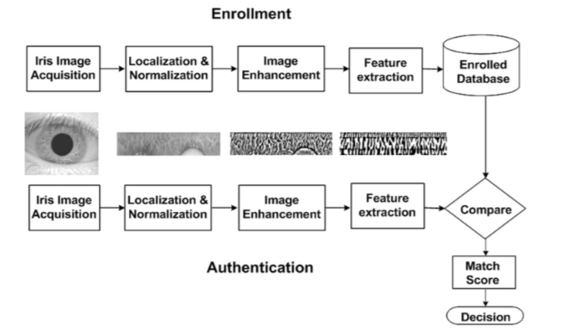
Methodology
Fig (b): System authentication process
Notes:
Ation

Slide 14
Methodology
MLDIVIDE ALGORITHM
The mldivide operator employs different solvers to handle different kinds of coefficient matrices. The various cases are diagnosed automatically by examining the coefficient matrix.
The versatility of mldivide in sloving linear systems from its ability to take advantage of symmetries in the problem by dispatching to an appropriate slover. This approach aims to minimize computation time.
The MATLAB mldivide functions prints a warning if A is badly scaled, nearly singular, or rank deficient. The distributed array mldivide is unable to check for this condition, if A is an M-by-N matrix with N>M, for distributed arrays. Mldivide computes a solution that minimize norm(X).
By using the mldivide algorithm the process is carried out in four steps as follows:

Slide 15
Methodology
Fundus acquisition : Devices used to obtain images of the retina were called fundus cameras, which uses low intensity infrared light to illuminate blood vessel pattern of the retina. Once the retinal image is obtained, the blood vessels are identified through further processing. Then from the complex network of blood vessels distinguishing features are extracted and stored in templates, which are later used in the matching process.
Pre-processing : In this step, it performs blood vessel enhancement and segmentation that helps to extract the retinal blood vessel pattern from fundus image. For this first of all we extract the green channel of the fundus image, because it provides highest contrast. This consists of five stages: resolution hierarchy creation, hessian vesselness extraction, back sampling, Hysteresis thresholding and image fusion.

Slide 16
Methodology
Detection of bifurcation points : Bifurcation are the most reliable and abundant feature in fundus images. The retinal bifurcation points are unique for each person, so they are used for successive process of identification of person. It detects bifurcation points with the help of Skeletonization process.
Feature matching : In the matching stage, the reference pattern, p, which is stored in database for the claimed identity is compared to the pattern extracted, p’, during the previous stage. Due to the eye movement during the image acquisition stage, it is necessary to align β with α in order to be matched. The movement of the eye in the image acquisition process leads to translation in both axes. So for same individual, the number of bifurcation points of both patters p and p’ are different. So it is necessary to transform the candidate pattern in order to get a pattern similar to the reference one.

Slide 17
Advantages and Disadvantages
Advantages:
The essential application for retinal example acknowledgment till date has been for physical access section for high-security offices, for example, army bases, atomic offices, modern research centers and so forth.
It is additionally utilized as a part of access control frameworks at high security offices.
There are many focal points of retina biometry:- it has low event of false positives, additionally offer to a great degree low (just about Zero%) mistake rates, since no two individuals have same retinal example it is exceedingly dependable and it can give expedient outcomes that is personality of a man can be checked rapidly.

Slide 18
Advantages and Disadvantages
Disadvantages:
Retina based security framework works by attaching a picture of a person's retinal vein system and contrasting it with a formerly confirmed sweep of a similar person.
The uniqueness and solidness of retina ensures a solid biometric confirmation. Likewise it is less defenseless against fraud.

Slide 19
Conclusion
The given Retina based individual recognizable proof framework utilizing skeletonization and comparability change, is a straightforward and productive framework for distinguishing legitimacy of individuals. The utilization of hessian based vessel division technique removes the total retinal vessel tree from fundus picture. Accordingly we can remove all highlights. Skeletonization develops the skeletal structure of retinal vessels. From the after effect of skeletonization, the pixel order technique identifies all bifurcation focuses in the image. These recognized bifurcation focuses are utilized as highlights in coordinating stage. In the coordinating stage, the obtained design is coordinated with the reference one put away in database of the framework. Here, the level of comparability is measured utilizing closeness metric. Consequently the proposed framework can create an exact outcome. Likewise it offers amazingly low blunder rate. The framework requires less calculation time. It is a basic and productive strategy for checking confirmation of client.

Slide 20
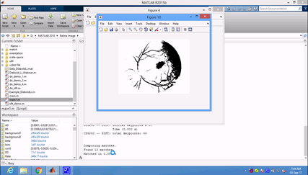
Snapshots
Fig 2: Main screen of the application
The above screen shot is the main screen which will be opened once the application is executed.

Slide 21
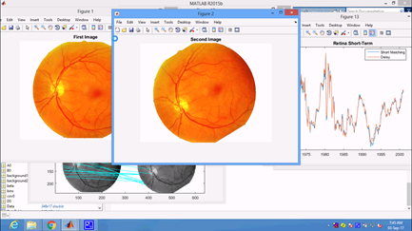
Snapshots
.
Fig 3: Fundus acquisition stage
The above snapshot gives the 2 images, one is the main images which are compared with the second images, both images graph and other feature is extracted once the pre processing is carried out. There is a high accuracy of finding the matching of the images.

Slide 22
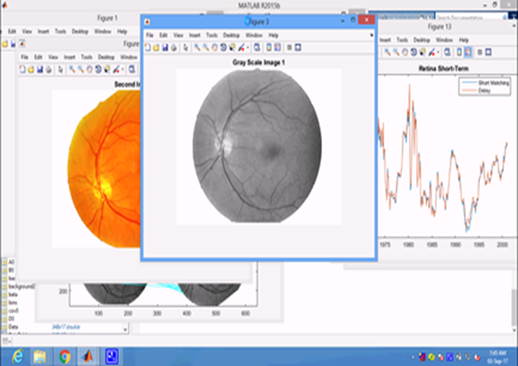
Snapshots
Fig 4: Pre-processing stage
The above screenshot gives the gray scale of the image 1 which is done at the time of pre-processing step , once this step is done , the preprocessing of the image2 also carried out.

Slide 23
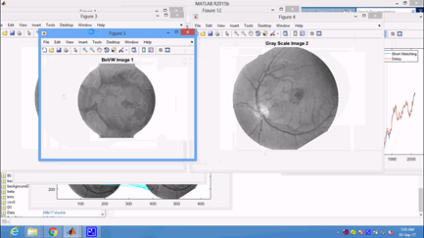
Snapshots
Fig 5: Converting the gray scale image into black and white format
The gray scale image is now converted into the black and white format for the exact feature extraction after the pre-processing step is done.

Slide 24
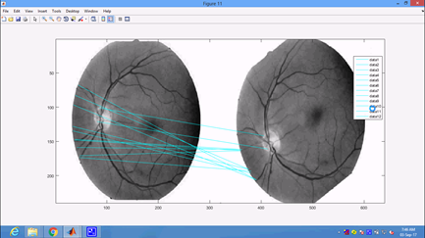
Snapshots
Fig 6: Feature matching stage
The above screenshot is giving the 2 images which we are matching here, the two retina images after the processing and segmentation, now the feature extraction process is initiated which will make the process to finalize the matching step.

Slide 25
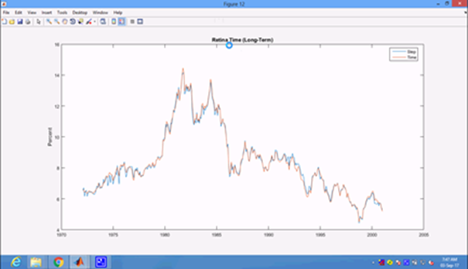
Snapshots
Fig 7: Retina long-term graph
The above graph is the final graph representation of the both the graph, from the graph one can understand the matching functionality of the 2 images. The above graph is the retina time i.e. long-term graph is shown.
.

Slide 26
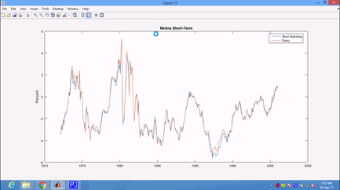
Snapshots
Fig 8: Retina short term graph
The above graph is another type of the graph of the 2 retina images. This is called as retina short term graph and short matching and delay is calculated here. The process involves this step after the pre-processing and feature extraction is done.

Slide 27
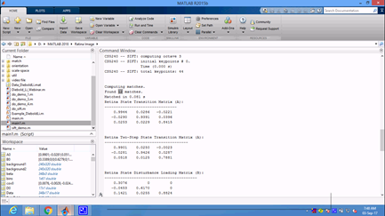
Snapshots
Fig 9:Final output of time taken
The output gives the time taken for each type of the operation to be processed. And retina values of the 2 images which has been submitted for the sake of processing. This will give the number of matched in this case it is given as 12 and also the time taken for the matching process to be done.

Slide 28
References
[1] J. Daugman, “How iris recognition works,” IEEE Trans. Circuits Syst.Video Technol., vol. 14, no. 1, pp. 21–30, Jan. 2004.
[2] J. Daugman, “Probing the uniqueness and randomness of IrisCodes:Results from 200 billion iris pair comparisons,” Proc. IEEE, vol. 94,no. 11, pp. 1927–1935, Nov. 2006.
[3] Unique Identification Authority of India. [Online]. Available:http://uidai.gov.in, accessed Nov. 1, 2015.
[4] K. R. Nobel, “The state of the art in algorithms, fast identificationsolutions and forensic applications,” MorphoTrust USA,Billerica, MA, USA, Tech. Rep., Jan. 2013. [Online]. Available:http://www.planetbiometrics.com/article-details/i/1446/.
[5] P. E. Peterson et al., “Latent prints: A perspective on the state of the science,” Forensic Sci. Commun., vol. 11, no. 4, pp. 1–9, 2009
[6] C. Champod, “Edmond Locard—Numerical standards and ‘probable’ identifications,” J. Forensic Identificat., vol. 45, no. 2, pp. 136–163,1995

Slide 29
References
[7] K. McGinn, S. Tarin, and K. W. Bowyer, “Identity verification using iris images: Performance of human examiners,” in Proc. IEEE 6thInt. Conf. Biometrics, Theory, Appl., Syst. (BTAS), Sep./Oct. 2013,pp. 1–6.
[8] H. Proenca, “Iris recognition: On the segmentation of degraded imagesacquired in the visible wavelength,” IEEE Trans. Pattern Anal. Mach.Intell., vol. 32, no. 8, pp. 1502–1516, Aug. 2010.
[9] H. Proenca, S. Filipe, R. Santos, J. Oliveira, and L. A. Alexandre, “TheUBIRIS.v2: A database of visible wavelength iris images captured on the-move and at-a-distance,” IEEE Trans. Pattern Anal. Mach. Intell.,vol. 32, no. 8, pp. 1529–1535, Aug. 2010.
[10] Z. Sun, L. Wang, and T. Tan, “Ordinal feature selection for iris andpalmprint recognition,” IEEE Trans. Image Process., vol. 23, no. 9,pp. 3922–3934, Sep. 2014.
[11] M. S. Sunder and A. Ross, “Iris image retrieval based onmacro-features,” in Proc. 20th Int. Conf. Pattern Recognit., 2010,pp. 1318–1321.

Slide 30
References
[12] J. De Mira and J. Mayer, “Image feature extraction for applicationof biometric identification of iris—A morphological approach,”in Proc. Brazilian Symp. Comput.Graph. image Process., 2003,pp. 391–398.
[13] F. Shen, “A visually interpretable iris recognition system with crypt features,”Ph.D. dissertation, Dept. Computer. Sci. Eng., Univ. Notre Dame,Notre Dame, IN, USA, 2014
[14] F. Shen and P. J. Flynn, “Using crypts as iris minutiae,” Proc. SPIE,vol. 8712, p. 87120B, May 2013.
[15] F. Shen and P. J. Flynn, “Iris matching by crypts and anti-crypts,” inProc. IEEE Conf. Technol. Homeland Secur., Nov. 2012, pp. 208–213.
[16] F. Shen and P. J. Flynn, “Are iris crypts useful in identity recognition?”in Proc. IEEE 6th Int. Conf. Biometrics, Theory, Appl., Syst.,Sep./Oct. 2013, pp.
[17] F. Shen and P. J. Flynn, “Iris crypts: Multi-scale detection and shapebasedmatching,” in Proc. IEEE Winter Conf. Appl. Computer. Vis.,Mar. 2014, pp. 977–983.=

Slide 31
References
[18] J. Chen, C. W. Harvey, M. S. Alber, and D. Z. Chen, “A matchingmodel based on earth mover’s distance for tracking Myxococcusxanthus,”in Proc. Med. Image Comput. Comput.-Assist. Intervene., 2014,pp. 113–120.
[19] J. Chen, F. Shen, D. Z. Chen, and P. J. Flynn, “Iris recognition based features,” in Proc. IEEE Int. Conf. Identity, Secure. onhuman-interpretable Behavior Anal. (ISBA), Mar. 2015, pp. 1–6.
[20] CASIA Iris Image Database. [Online]. Available: http://biometrics.idealtest.org/, accessed Nov. 14, 2015.

Slide 32
Thank You…

